Slide 1
Computational Properties of Neural Columns arising from Temporal Dynamics
Vincent Baker
Drexel University Department of Physics

Slide 2
Thesis
The big question: how does cognition arise from the biophysical organization of the brain?
Research question: Can columns of neurons encode time series inputs into high-order dynamic states that facilitate classification?
Research approach: Simulate neural columns in the liquid state machine computational model, measure the effects of physical properties on computational performance in classifying time series inputs

Slide 3
Impact
Deeper understanding of biological neural circuits
Creates new measures of computational capability for biological networks
Biologically plausible adaptation mechanisms
New understanding of the role of neural dynamics in cognition
Improved liquid state machines for machine learning
Improved computational properties inspired by biological neuron dynamics
Fast implementation on application-specific hardware

Slide 4
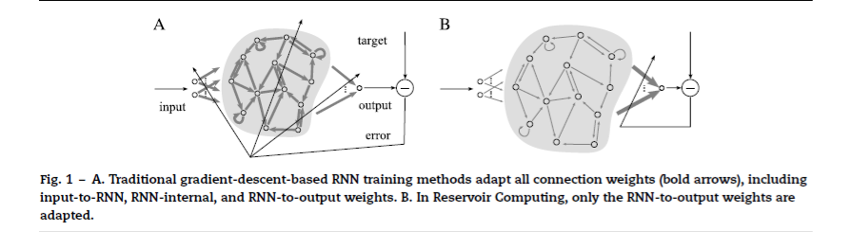
Liquid State Machines
Nonlinear “liquid” with fading memory is driven by an input
The input evokes complex dynamics in the liquid
A linear readout map extracts the desired data from the liquid
Lukosevicius and Jaeger 2009

Slide 5
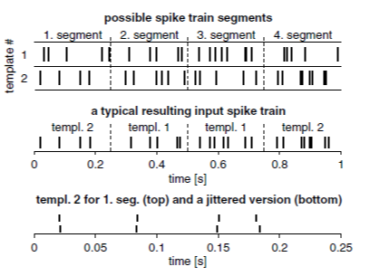
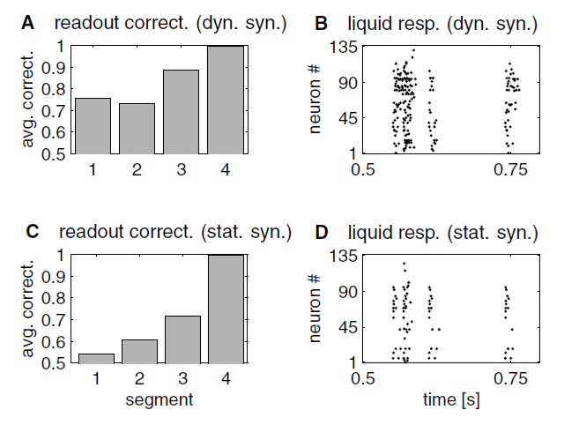
Fading memory
Maas et al showed that a reservoir with fading memory retains information about time history in its dynamic state
LSM was able to classify all 4 segments in a 1 second sequence based only on the liquid state at t=1 second
Maas2002 demonstrated that fading memory created by dynamic synapses (right, top) can recognize past events in a time series. The network with static synapses (right, bottom) showed limited memory.

Slide 6
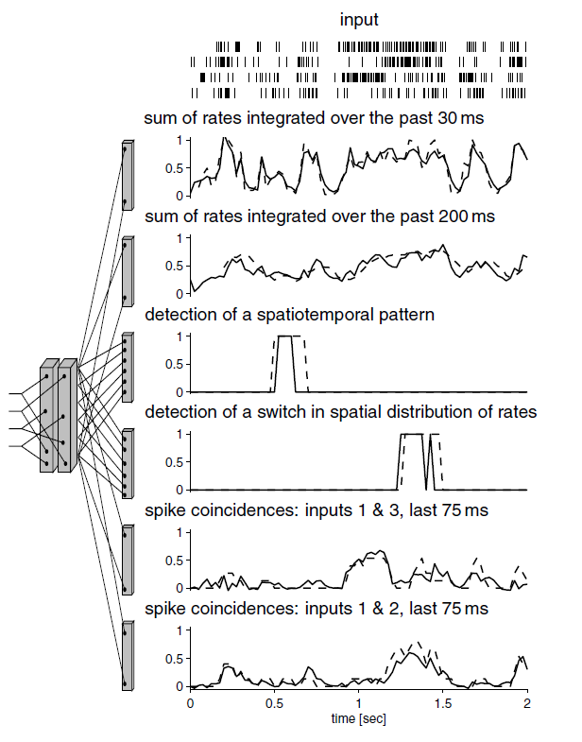
Multiple readouts
Multiple linear readouts can be trained to extract different information from a single reservoir
Simple adaptation mechanism for new information that does not disturb previously trained readout maps
Desirable property for adaptive learning where all classes are not known a priori
6 readouts extracting diverse information from the same reservoir for the same input. Actual values plotted as dashed lines, readout response are solid lines (Maas 2002)

Slide 7
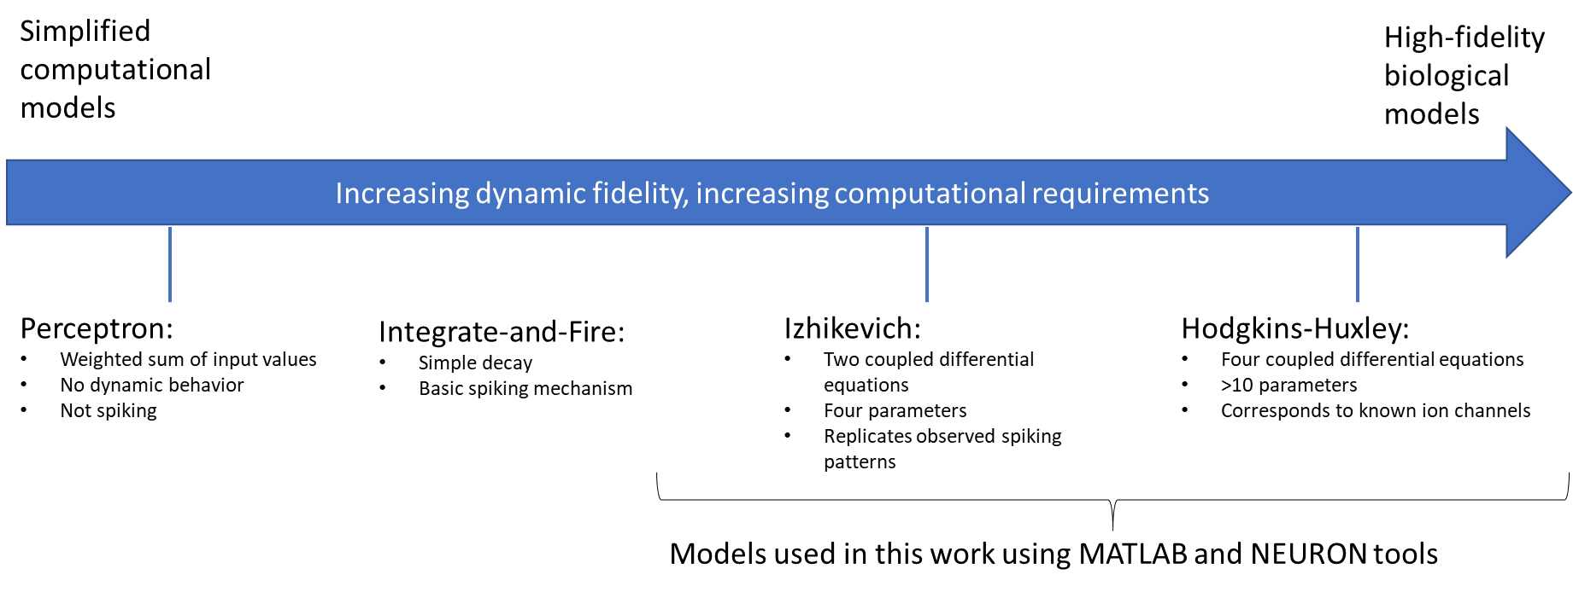
Neural models
Neural dynamics play an important role in temporal response
We start with the Izhikevich model, a simplified 2D dynamic system
Can explore nonlinear dynamics while retaining fast simulation

Slide 8
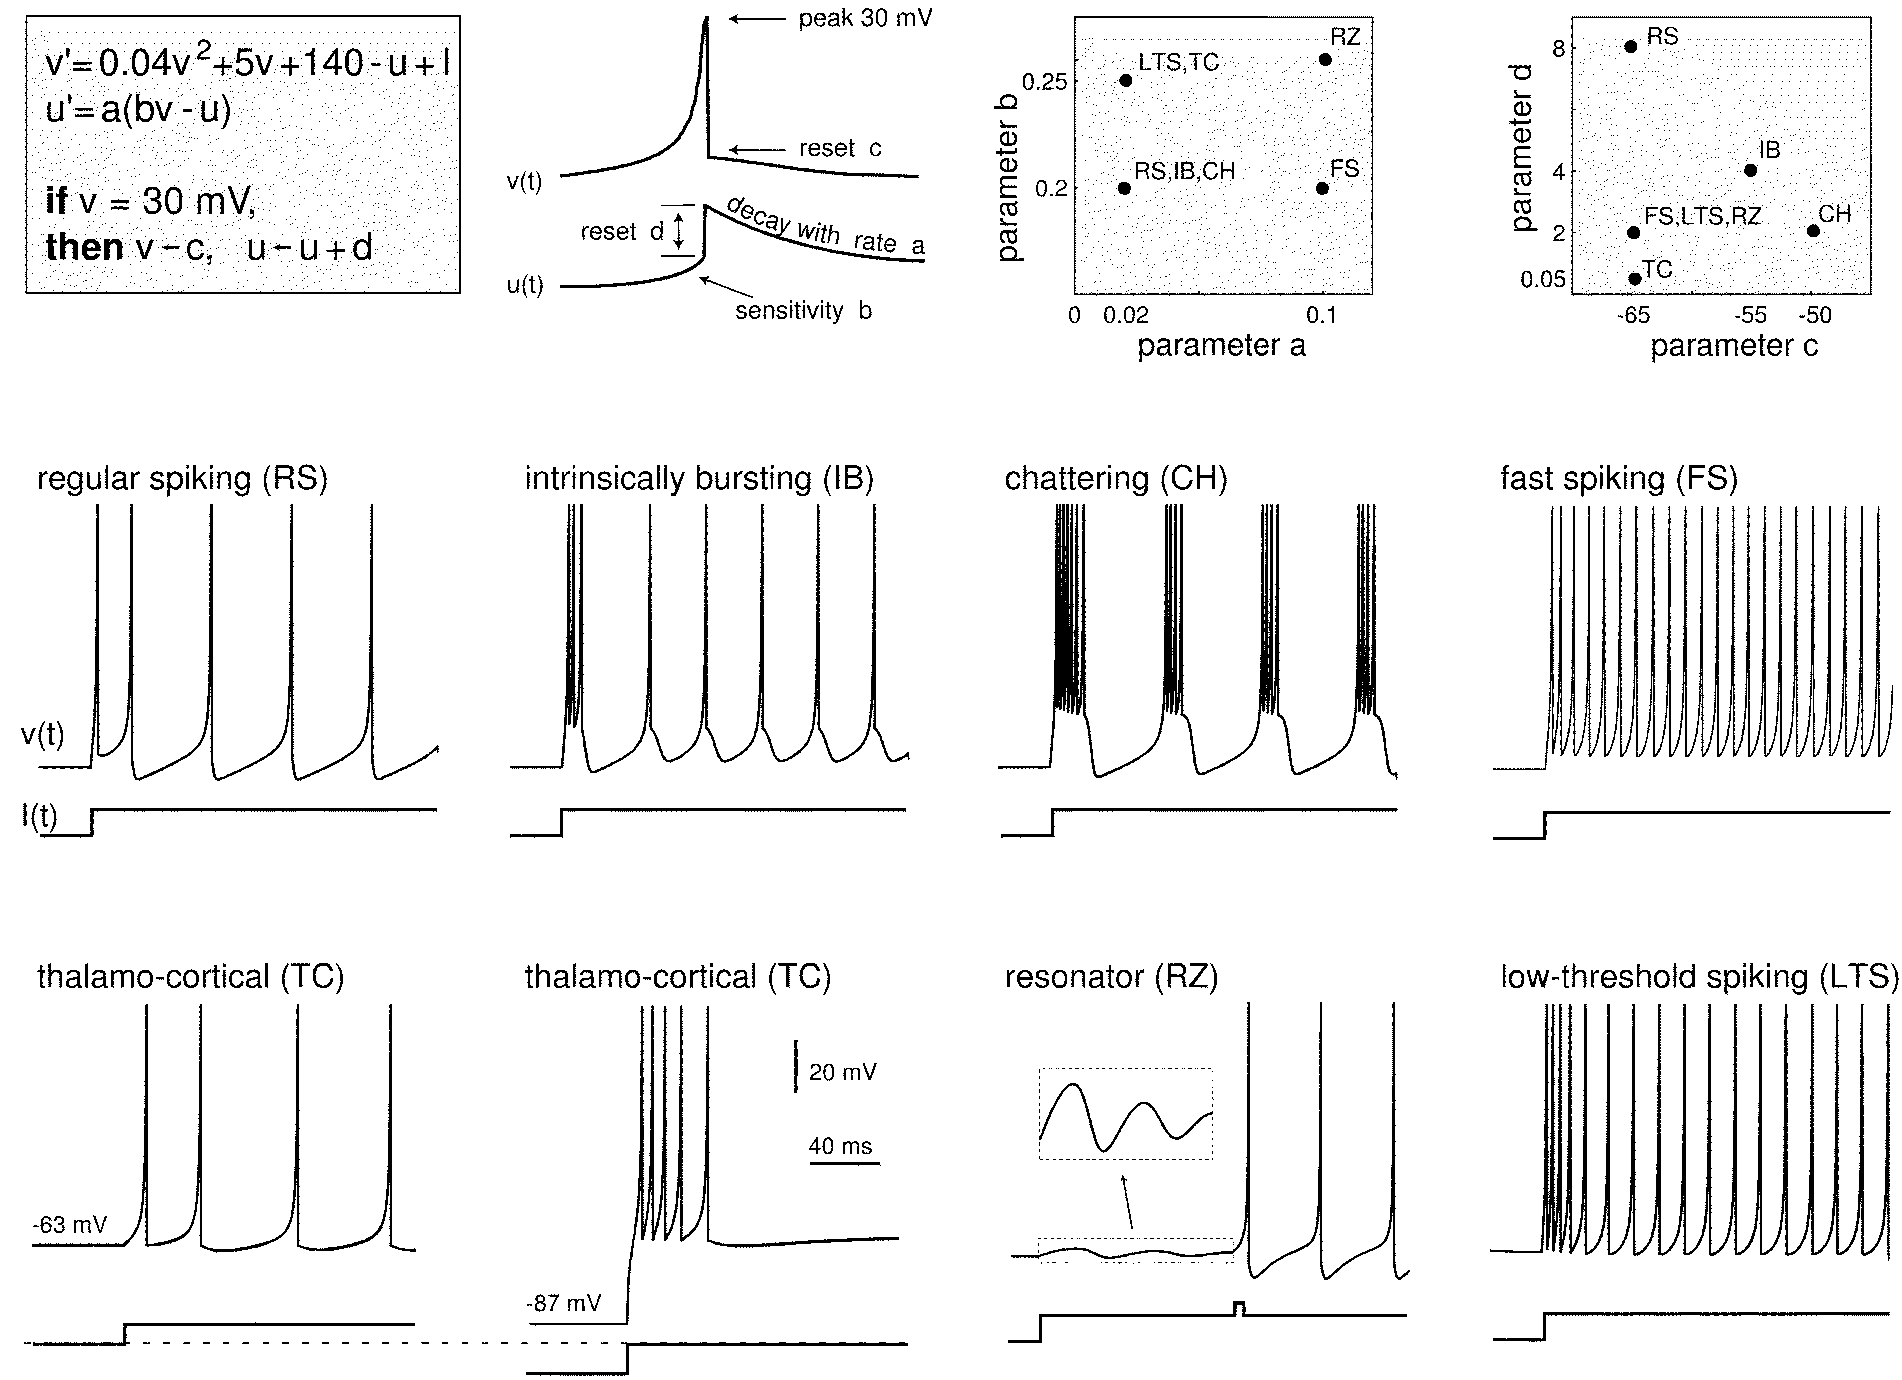
Izhikevich model
Differential equations with threshold and reset
Simple system for exploring two-dimensional dynamics
Provides dynamic degrees of freedom not seen in LIF neurons used in previous LSM work
The Izhikevich model can replicate common spiking patterns with the appropriate choice of parameters (Izhikevich 2003)

Slide 9
Spatial organization
Columns and proposed function
Microcolumn structures and correlation to age-related decline in Rhesus monkeys

Slide 10
Results

Slide 11
Problem
Simulated a small neural column
MATLAB model
Izhikevich dynamics, extended to support action potential propagation times
Column structure based on Maas
Distance-dependent connectivity based on Maas
Demonstrated that neural model with delays retains basic properties of Izhikevich model
Demonstrated that distance-dependent delays can be a critical parameter in synchronized firing
Showed that the propagation speed of a population “wave” depends on the width of the neural column
Showed that the neural circuit dynamics encode information about the input spike trains

Slide 12
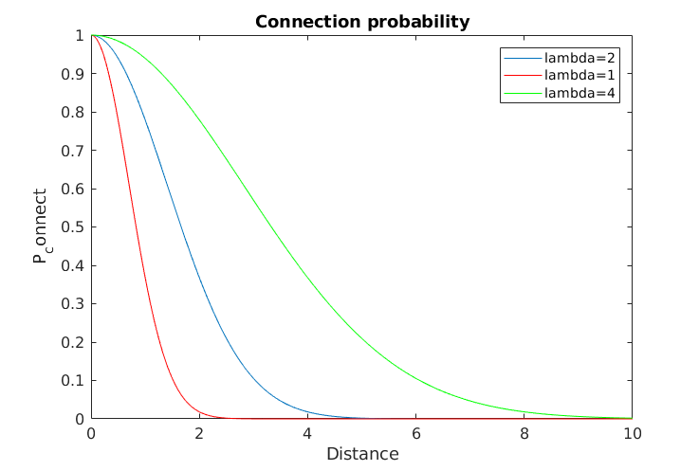
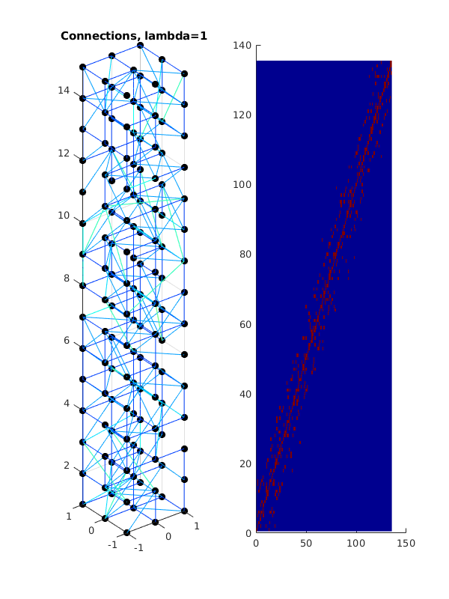
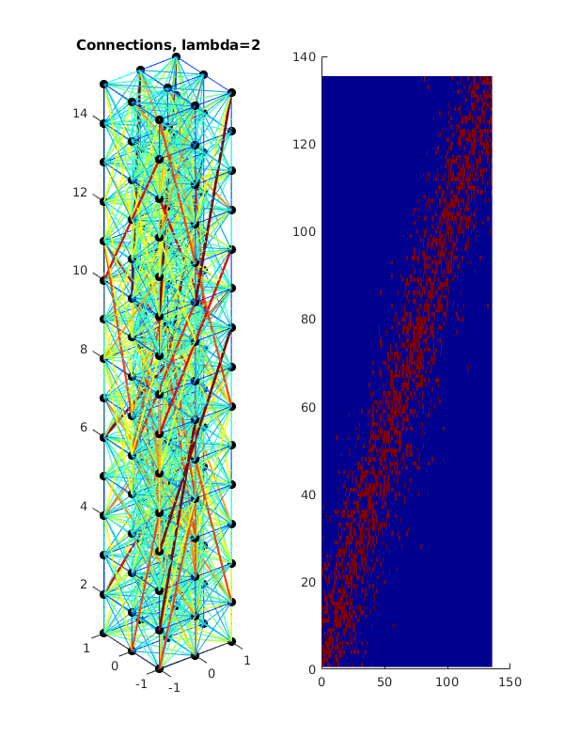
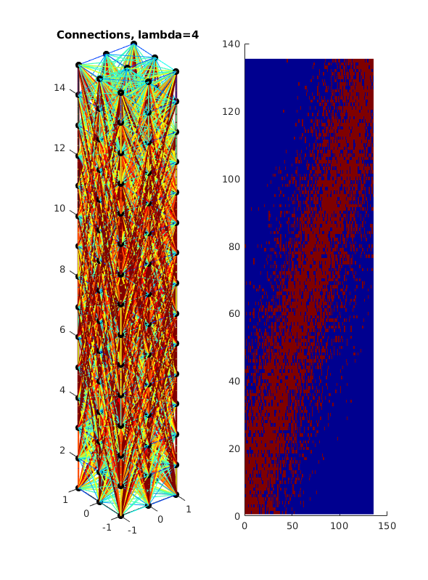
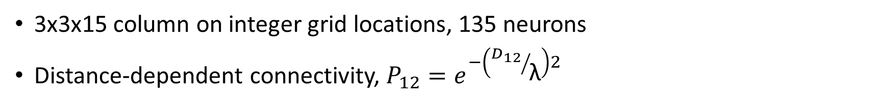
Column model
3x3x15 column on integer grid locations, 135 neurons
Distance-dependent connectivity, $P_{12}=e^{−\left({D_{12}}/{\text{λ}}\right)2}$

Slide 13
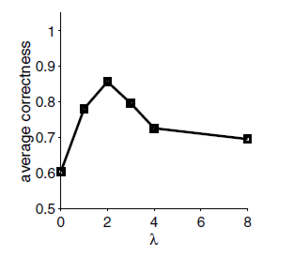
Neural connectivity
Original LSM paper (Maas 2002) found best performance for λ=2
This work will explore how spatial organization and connectivity of the columns effect performance
The liquid neural network performed best with a mix of local and global connectivity (Maas 2002)

Slide 14
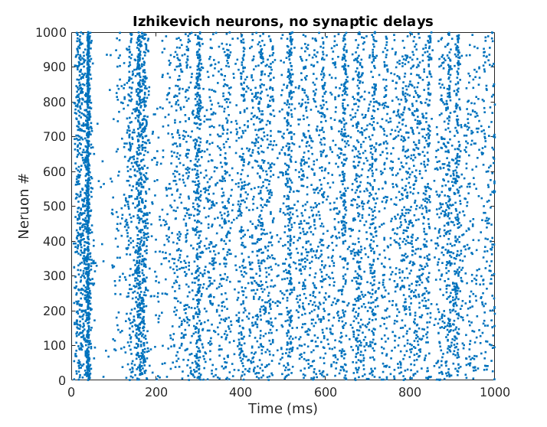
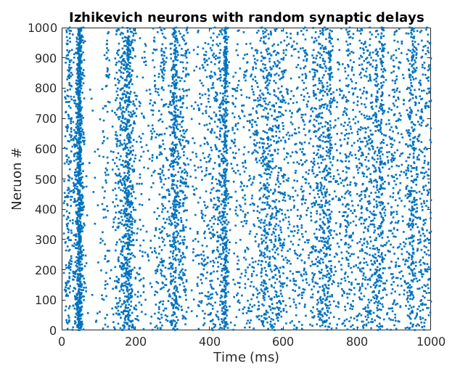
Neural models
Original LSM set all propagation delays to 1.5 ms regardless of position
We extended Izhikevich simulation to include propagation delay
Our model retains basic behavior of the Izhikevich model
The original Izhikevich model (left) and our extended model with random delays (right) both show synchronization in response to randomized “thalamic” input (Izhikevich 2003, https://www.izhikevich.org/publications/spikes.htm)

Slide 15
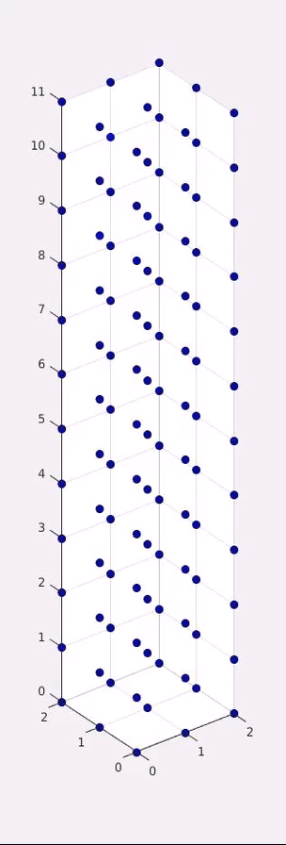
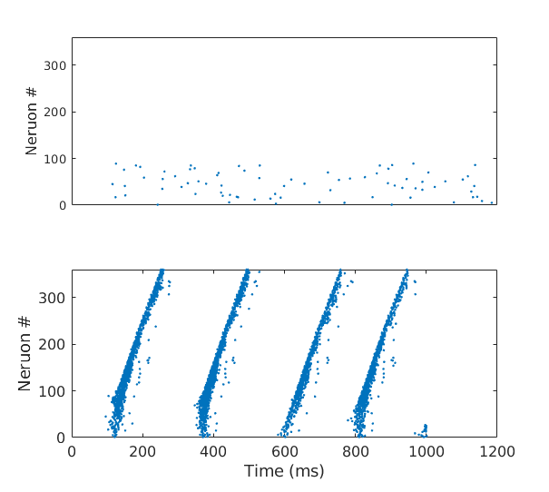
Delay-induced synchronization
Stimulated neurons in bottom 25% with random background, observed wavelike propagation up the column
Demonstrated that the distance-dependent delay can be a critical parameter for synchronized firing with propagation
Column with random propagation delays, no synchronized firing
Identical column with distance-dependent delays, we see synchronized firing that propagates up the column

Slide 16
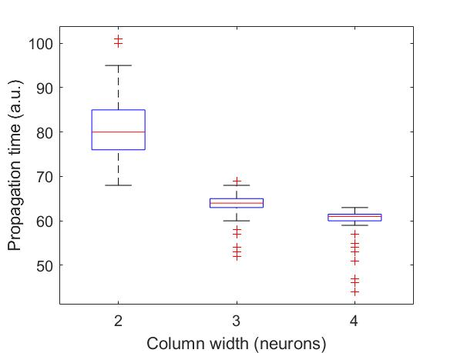
Propagation velocity
Propagating waves in neural circuits have been proposed as a mechanism for neural synchronization (Keane and Gong)
Neural column width affects effective propagation speed
Our group (J. Tumulty) has shown interesting synchronization phases in realistic neural networks with artificially slow propagation
Waves in a two-dimensional neural network (Keane and Gong)
Thinner columns exhibit slower effective propagation speed

Slide 17
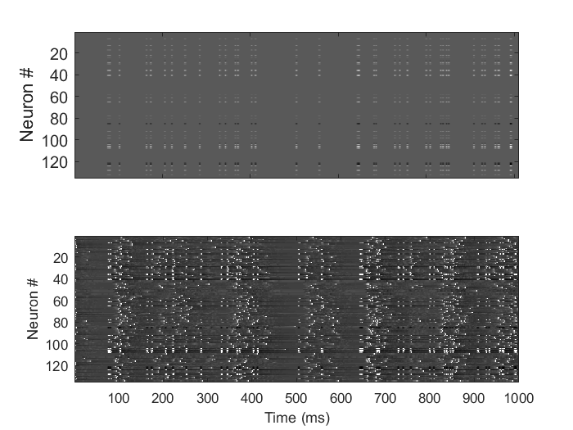
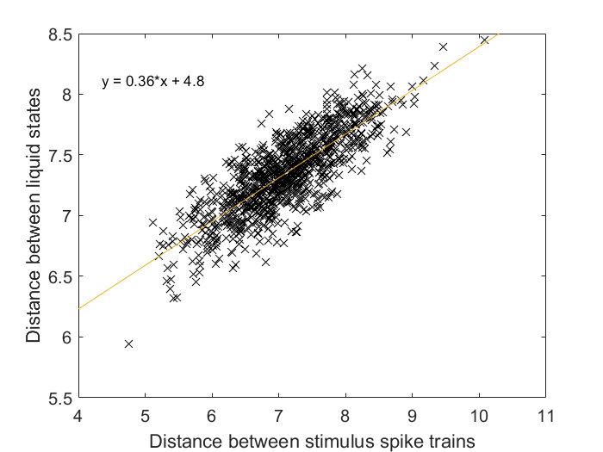
Distance metrics
Input distance vs. liquid state distance
(A)
(B)
Typical stimulus (A) and reservoir response (B)
The distance between the input spike trains is reflected in the reservoir response

Slide 18
Directions for future research

Slide 19
Further work
LSM classifier based on current column model
Speech classifier based on TI46 speech corpus
Commercial data sets
Further dynamics investigations
Neuron dynamics, especially delayed firing near a bifurcation for slow propagation
Spatial organization effect, especially microcolumn structures
Highly realistic simulation
NEURON simulator with validated biological parameters
Efficient hardware implementation of LSM
Concepts for application-specific integrated circuits
Photonic implementation (Prucnal group at Princeton)

Slide 20
References

